Slide 1


Slide 2
Group Project
Presented by Meshari Alqeryan

Slide 3
Project Goal
This project aims to build a model that can accurately predict the churn possibility of existing customers for ABC Wireless Inc. We will apply data science principles and analytics methods to address this issue. In this project
R is used to implement the project analysis.

Slide 4
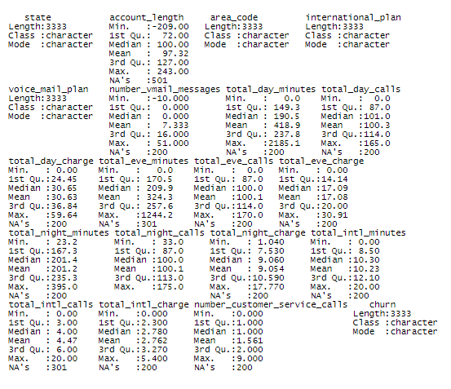
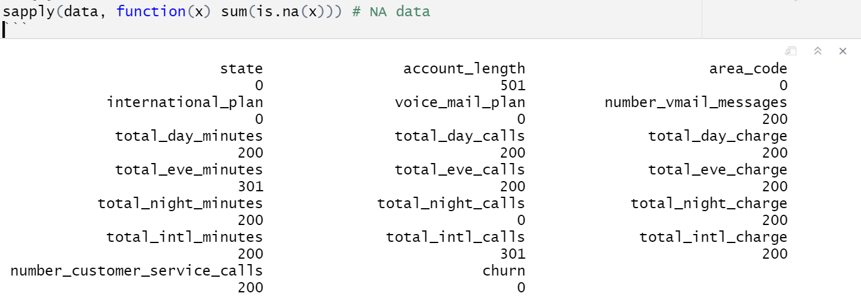
Data Overview and Analyzing

Slide 5
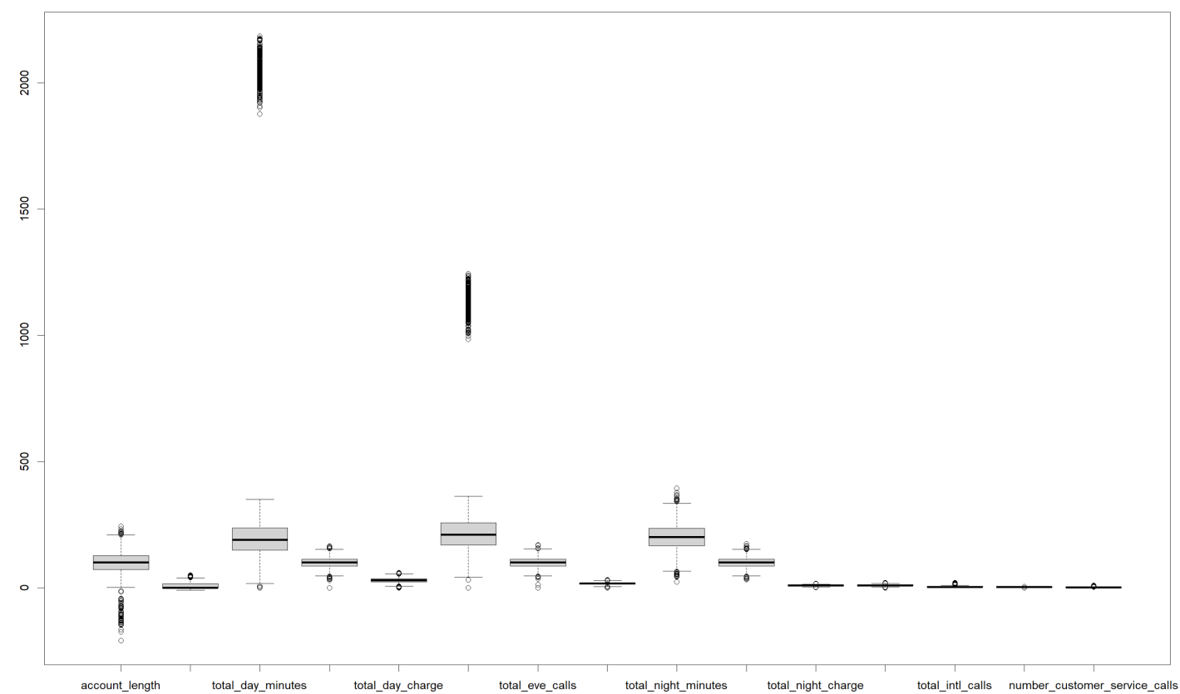
Data Overview and Analyzing

Slide 6
Data Preparation
After our analysis of the dataset is complete we can prepare the data for our model. The preparation goes as follows:
Missing data analysis: More than 200 missing data are in almost every column, yet we did not drop any columns or rows with missing values. All the missing values are imputed.
Outliers analysis: Outliers existed on two variables at approximately 12% which is considered minor and did not predict to affect the result of our model so we haven’t removed them completely.
Negative value analysis: some negative values were present for the variables “account_length” and “number_vmail_messages” which we decided to normalize them using the abs function.

Slide 7
Data Preparation
The preparation continues as follows:
Converting data into factors: to covert categorized data into factors to build the model
Data splitting: Splitting data into 70% training and 30% validation

Slide 8
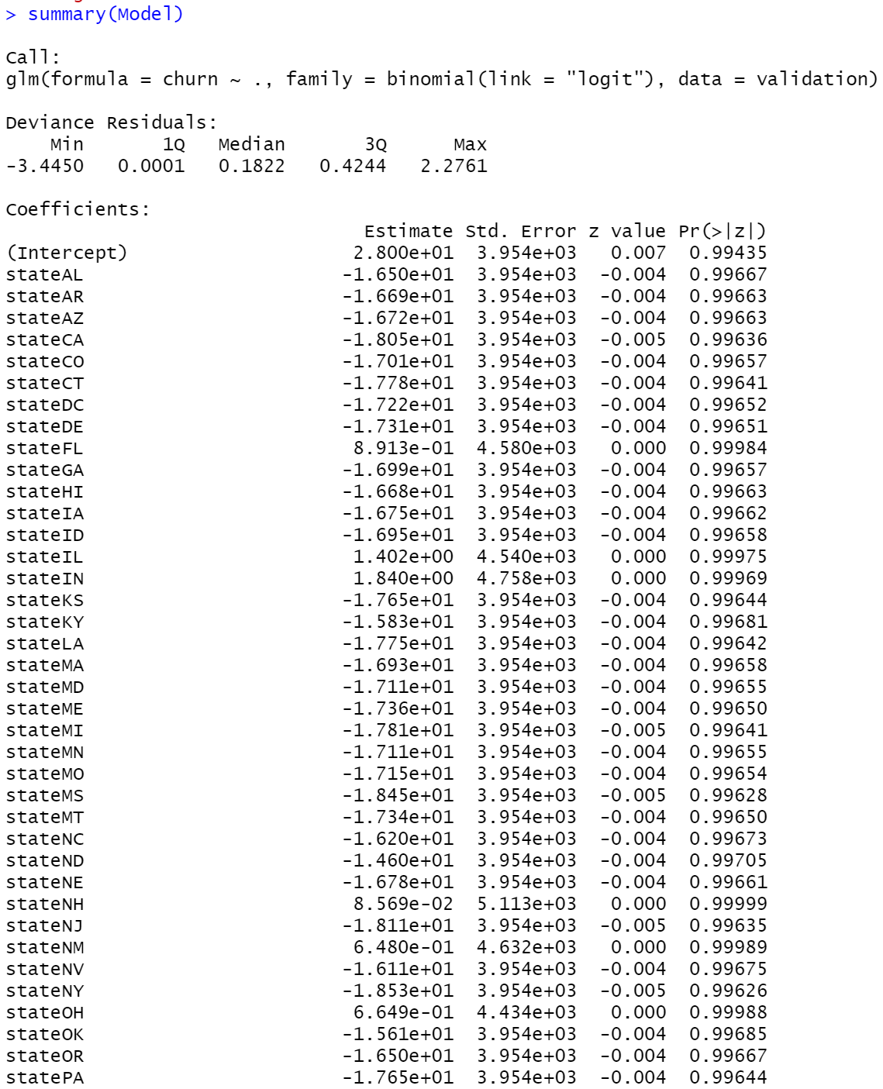
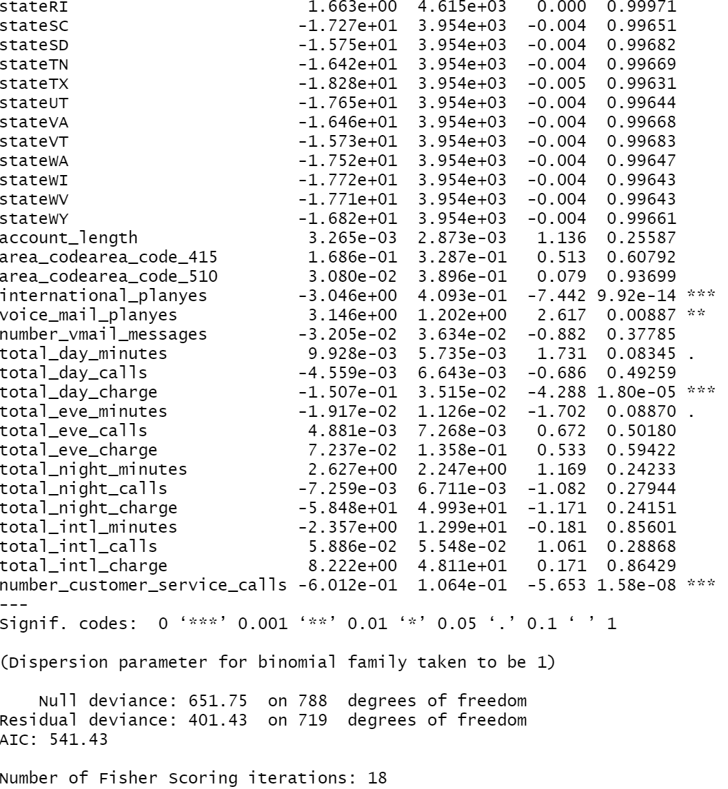
Model Building

Slide 9
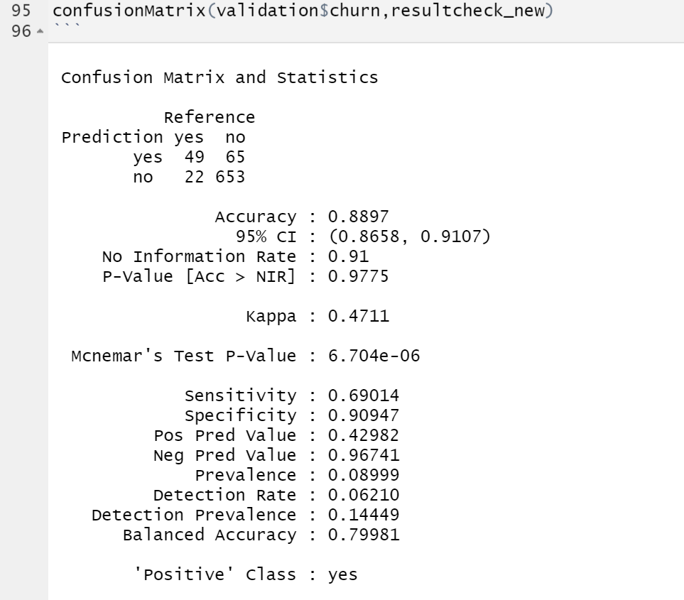
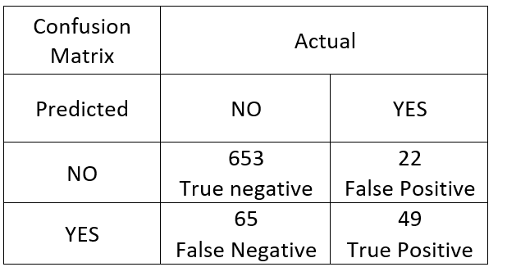
Model Validation
Confusion Matrix: we used a confusion Matrix to visualize the performance of our model.

Slide 10
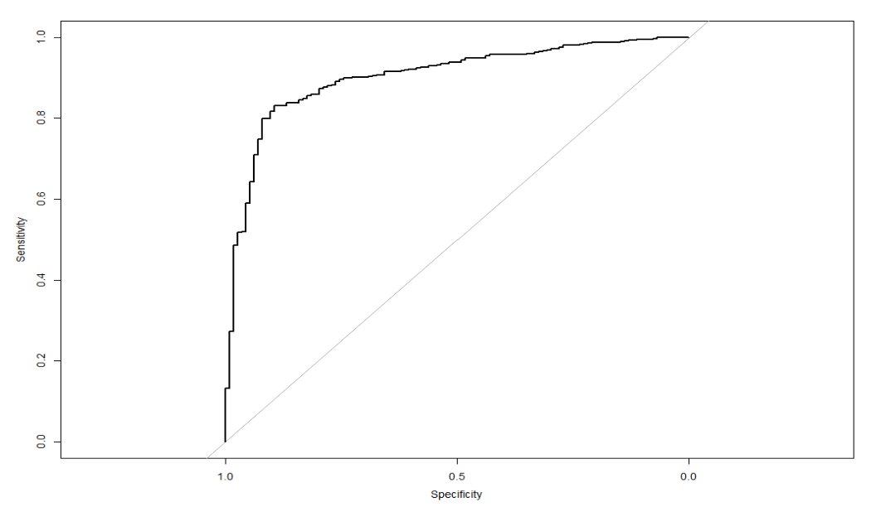

Model Validation
AUC (Area under Curve): For further checks, the second method we are using is the AUC of ROC (Receiver Operator Characteristic). We chose 0.5 as the threshold for making “yes” (or positive) predictions. The area under the curve for the model is 90% which is a very good indicator of our model being very accurate.

Slide 11
Overview and Discussion
The company wants to focus on not losing the existing customers as marketing the product and gaining new customers is expensive as compared to retaining the customers. The model we developed can predict 88.9 % accurate results.
The logistic regression model can help the company determine the customers likely to churn. The model uses state, international_plan, voice_mail_plan , total_day_charge , total_intl_calls, number_customer_service_calls as predictors.
As per the model prediction, the company can offer suitable offers only to those that customers are going to churn to other competitors to prevent that from happening.

Slide 12
Overview and Discussion
In addition to the model prediction the company might add the below to maintain and reduce the churn rate.
After-sales services
Feedback option which will significantly improve churn prediction.
Advertising

Slide 13
Thank You.

